Slide 1
Monte Carlo Method
Presented by:
Iwan Njoto Sandjaja
All images from Wikipedia Common except stated otherwise

Slide 2
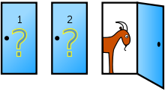
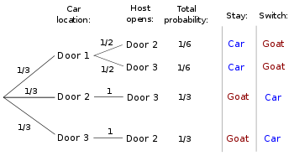
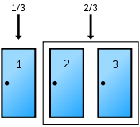
Monty Hall Problem
https://math.stackexchange.com/questions/608957/monty-hall-problem-extended

Slide 3

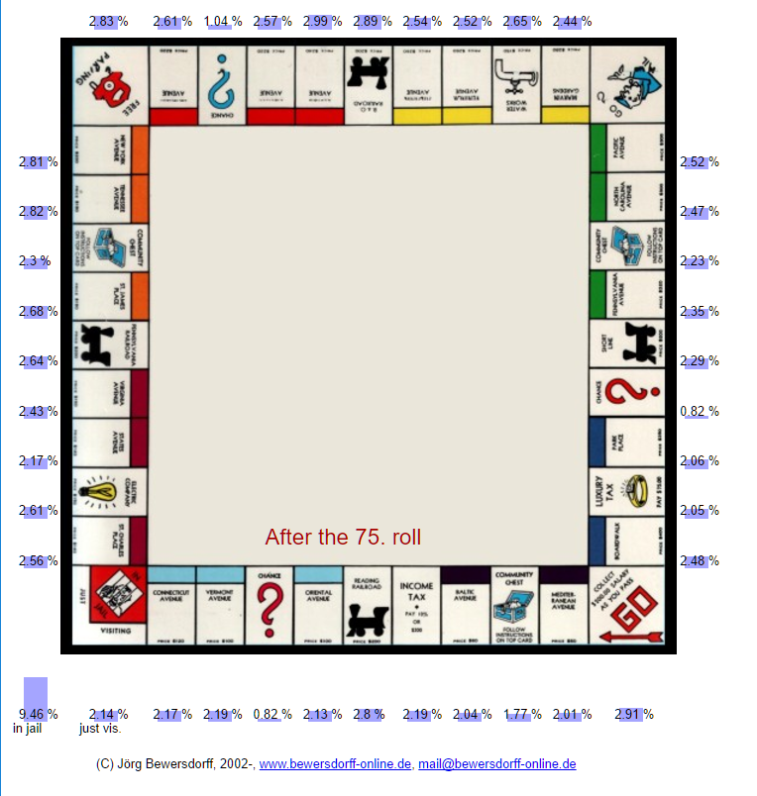
Monopoly
Probability of Going to Jail in Monopoly
Probabilities in the Game of Monopoly
http://www.bewersdorff-online.de/amonopoly/

Slide 4

Estimating Pi

Slide 5
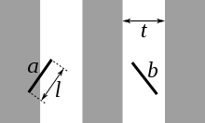
Suppose we have a floor made of parallel strips of wood, each the same width, and we drop a needle onto the floor. What is the probability that the needle will lie across a line between two strips?

Slide 6
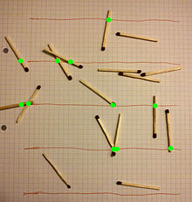
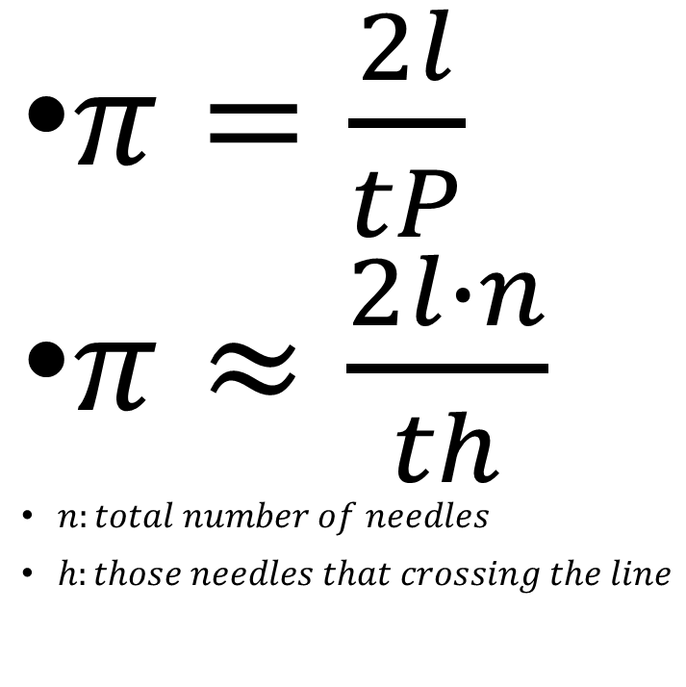
$π=\frac{2l}{tP}$
$π≈\frac{2l∙n}{th}$
$n:total number of needles$
$h:those needles that crossing the line$

Slide 7
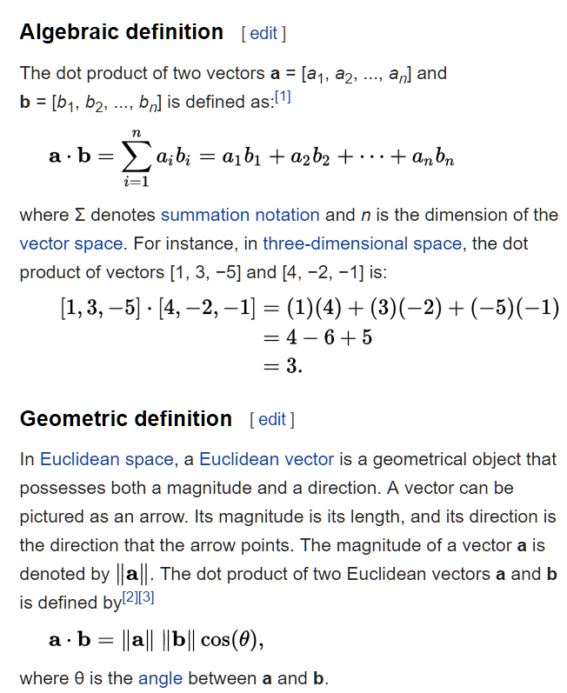
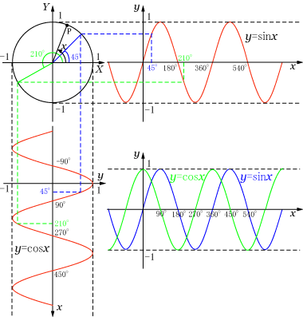

Slide 8

Netflix Prize – 2009 - US$1,000,000
Image from https://work.caltech.edu/telecourse.html

Slide 9


What Song Is This?
Search for music using your voice by singing or humming
Shazam

Slide 11


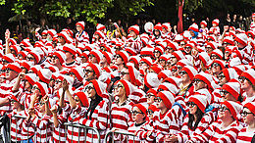
Where’s Wally?
http://cs231n.github.io/convolutional-networks/

